Slide 1

Review ReactJS Practice Two
Developer: Ba Thanh Nguyen
Mentor: Quyen Huynh
Supporter: Huy Pham

Slide 2







TECHNICAL
HTML5
module CSS
Axios
ReactJS
React Router
Storybook
mockAPI.io

Slide 3

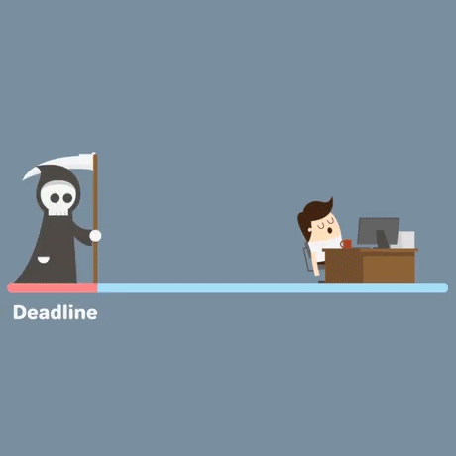
TIMELINE
11 days ( 2022/10/17 – 2022/10/31)

Slide 4
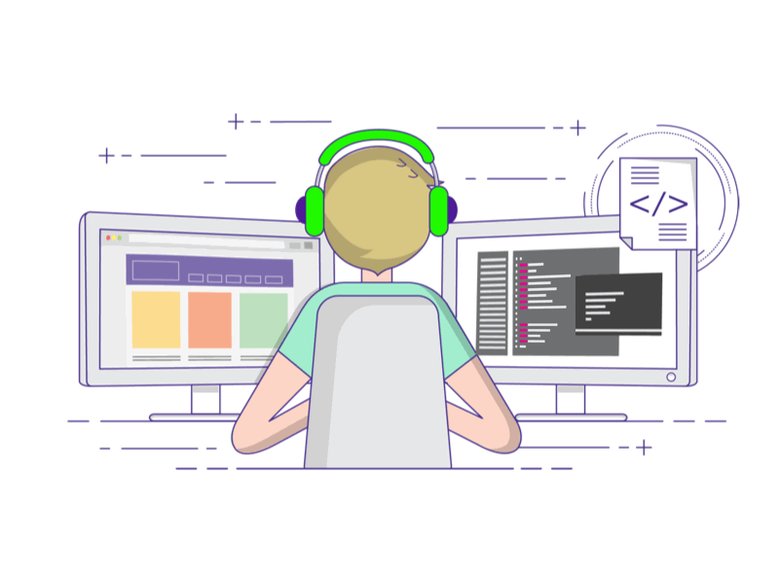
TEAM SIZE
1 DEV

Slide 5

TARGETS
Build an application for managing items using React (Ver 18.2.0)
Understand & apply knowledge of HTML5, Module CSS, Storybook, ReactJS
Understanding & applying React Hooks, React Context, React Router
Understand the importance of debug tools for front-end web developers (React DevTools, React perf,...)

Slide 6
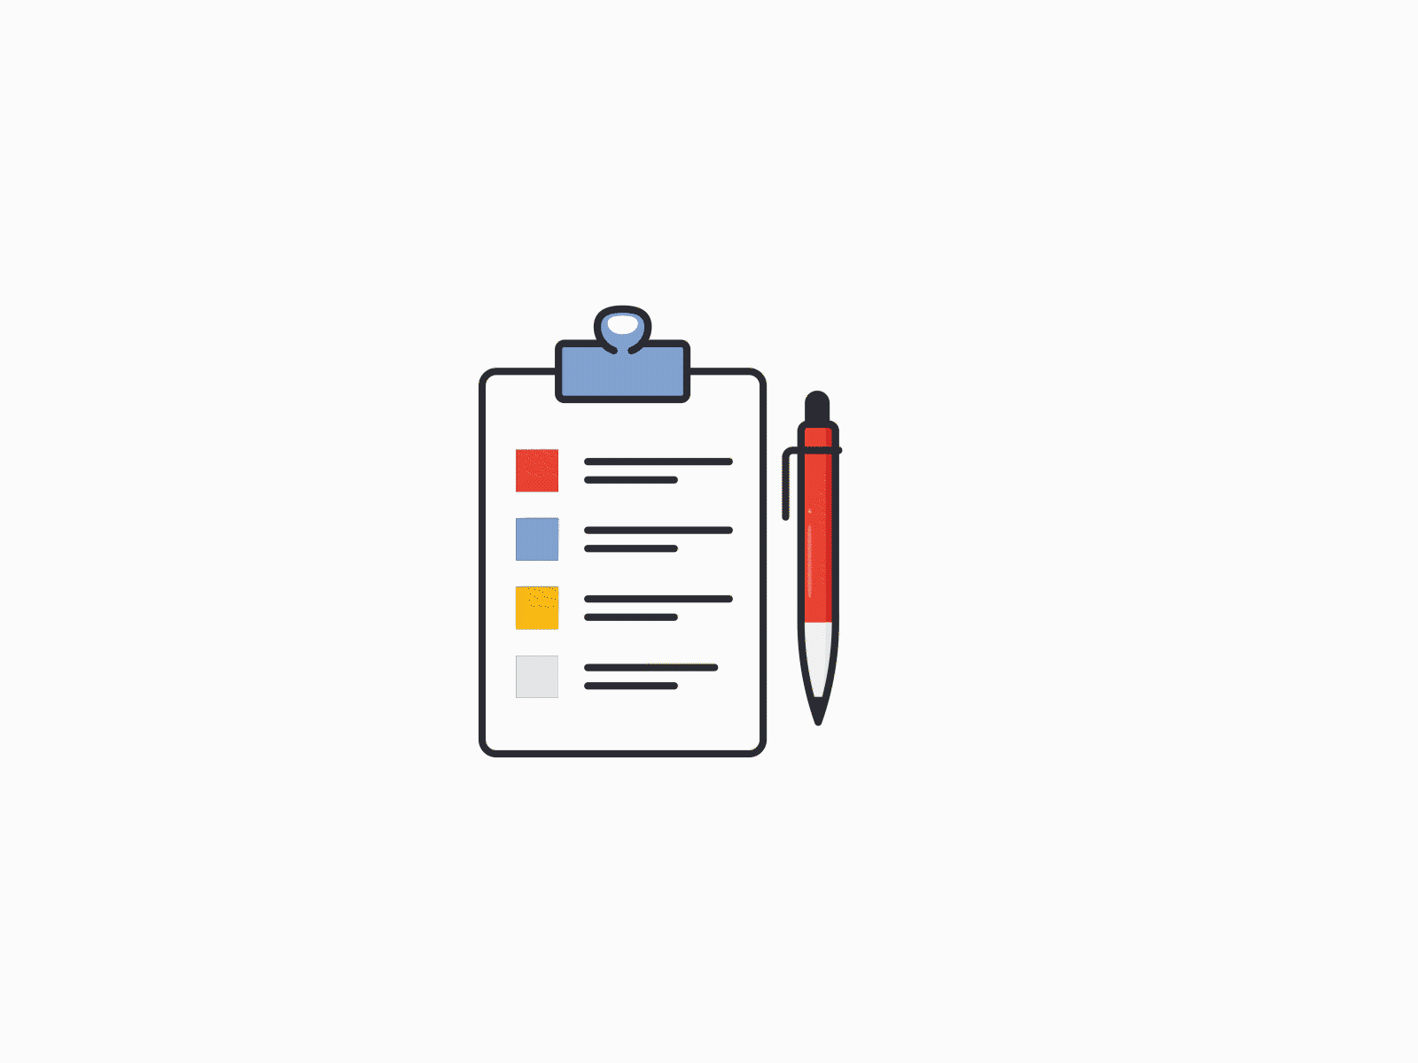
REQUIREMENTS
Create mocking data:
- Render the list of products.
Delete the product in the list:
- The user can delete the product when clicking the Delete button – Show the popup confirmation.
Create A New Product:
- The user can add a new product - Open the form to add a new one.
Search products by name:
-The user can search for the product by inputting the name of the product into the Search Bar.
Edit the product in the list:
-The user can edit the product when clicking the Edit button – Open the form to edit.
Sort Product:
- The user can filter products by category by clicking the category button.

Slide 7

ISSUES
The estimated number of working days is not correct.
The time to do React Practice-Two is later than expected.
The Storybook is still unclear.
The code has not been optimized.
Most React hooks have not been applied yet.

Slide 8

Demo

Slide 9
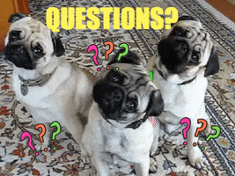
Q & A

Slide 10


